Slide 1
Preliminary analysis

Slide 2
Overall
212 response ratios (not counting the interseeding MI study) from 12 studies
115 of weed density (~29 that have zeros for the cover crop treatment which does allow for a response ratio calculation)
59% of response ratios are negative, meaning reduced weed density with a cover crop
121 of weed biomass (same problem with the zeros here)
67% of response ratios are negative, meaning reduced weed biomass with a cover crop

Slide 3
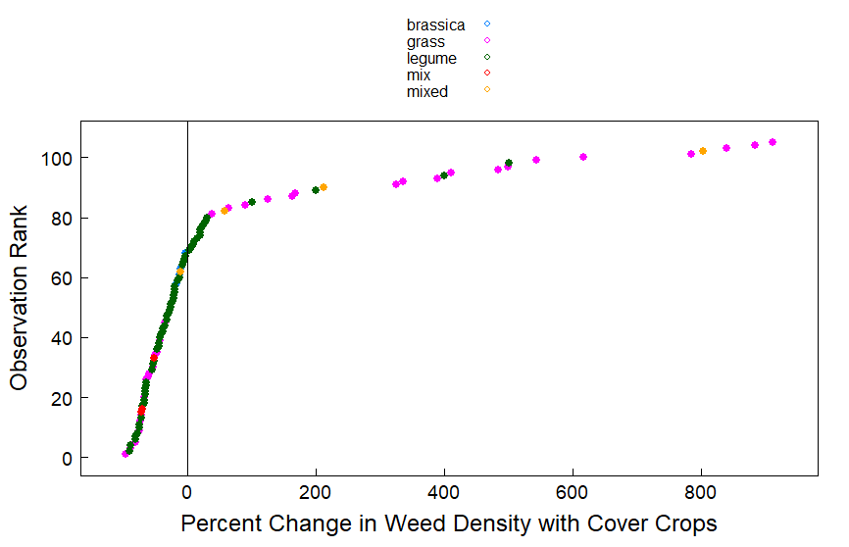
Overall distribution – weed density
Notes:
There are some big outliers here too. Do we need to investigate some of these studies or is it possible that cover crops are increasing weeds by 800% or more in some instances?

Slide 4
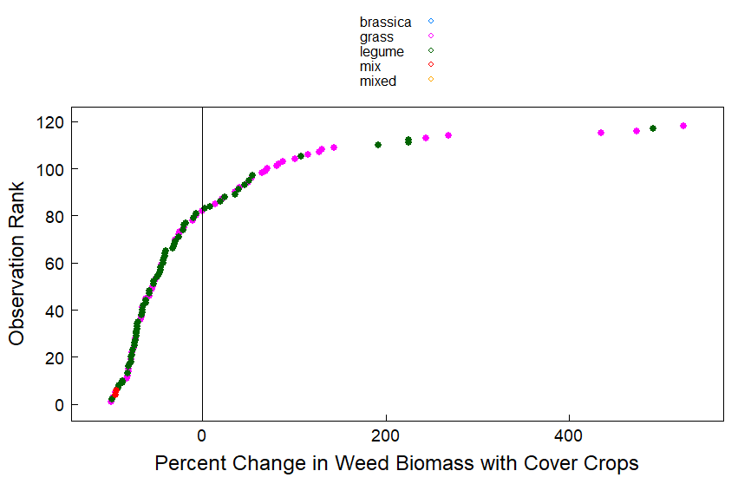
Overall distribution – weed biomass

Slide 5
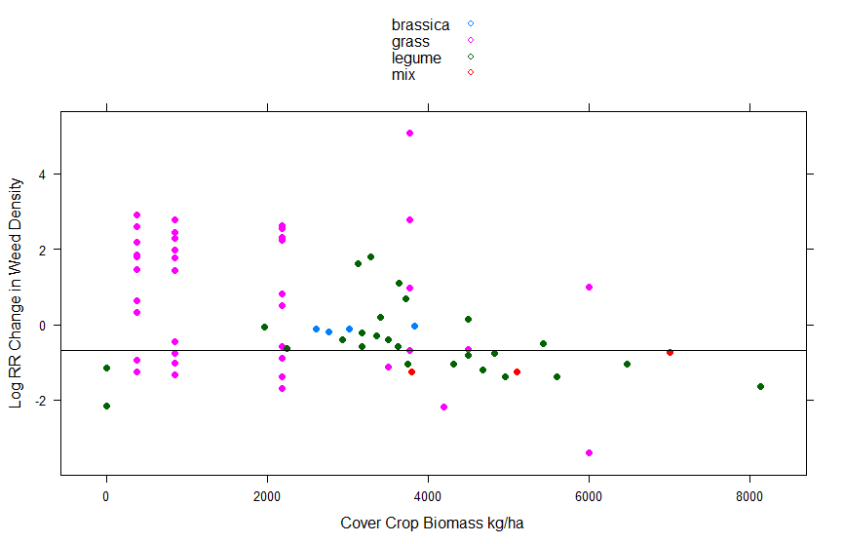
Cover crop biomass relationship to response ratios – weed density
50% weed control
Also the studies with the same amount of biomass and negative and positive response ratios is confusing to me. What’s causing this?
Notes:
The figures for cover crop biomass and weed density/weed biomass are not super clean. There is some pattern (I think) with more grass biomass leading to more weed control. I added a line at -0.69 which is the LN of 0.5 noting a 50% reduction in weed control. Drawing a value from that is a little difficult. We could consider evaluating the regression coefficients to come up with a number for biomass but I think we’re pretty far away from being able to say anything concrete yet.
Also the studies with the same amount of biomass and negative and positive response ratios is confusing to me. What’s causing this?

Slide 6
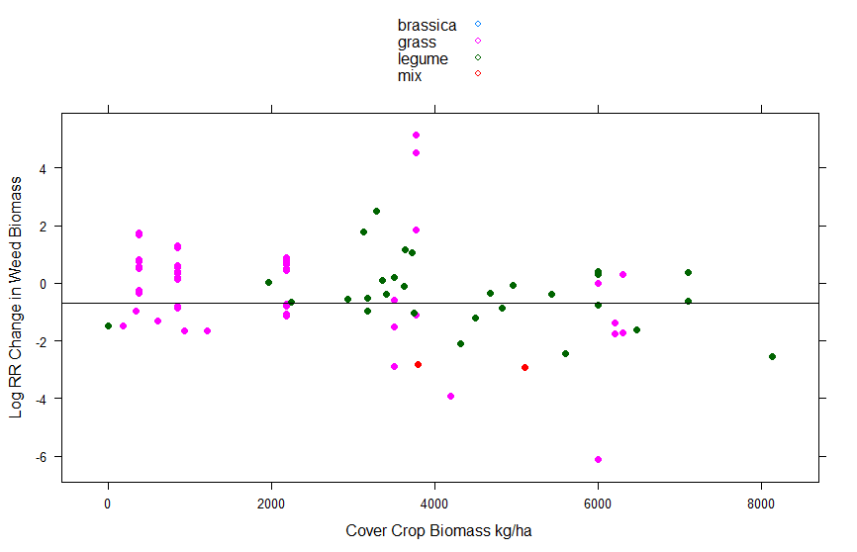
Cover crop biomass relationship to response ratios – weed biomass
50% weed control
Notes:
The figures for cover crop biomass and weed density/weed biomass are not super clean. There is some pattern (I think) with more grass biomass leading to more weed control. I added a line at -0.69 which is the LN of 0.5 noting a 50% reduction in weed control. Drawing a value from that is a little difficult. We could consider evaluating the regression coefficients to come up with a number for biomass but I think we’re pretty far away from being able to say anything concrete yet.
Also the studies with the same amount of biomass and negative and positive response ratios is confusing to me. What’s causing this?

Slide 7
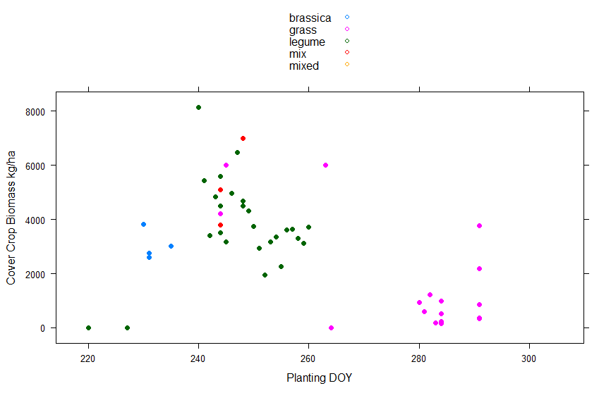
Relationship of planting / termination DOY and cover crop biomass

Slide 8
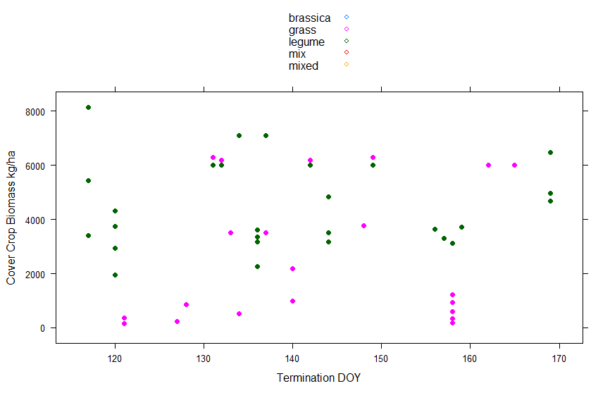
Relationship of planting / termination DOY and cover crop biomass
Notes:
I don’t see strong patterns with this or the planting DOY graphs

Slide 9
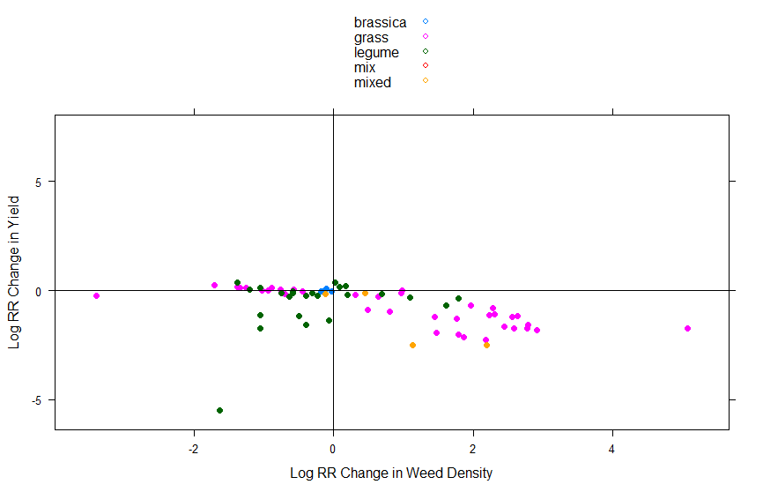
“win win” graphs – weed density
Win win
13 or 14%
3 or 3%
59 or 62%
20 or 21%
Lose lose
Notes:
Note that this would only graph where there was a RR for both weed density and yield
Again I’d want to double check my math so consider these numbers first estimates

Slide 10
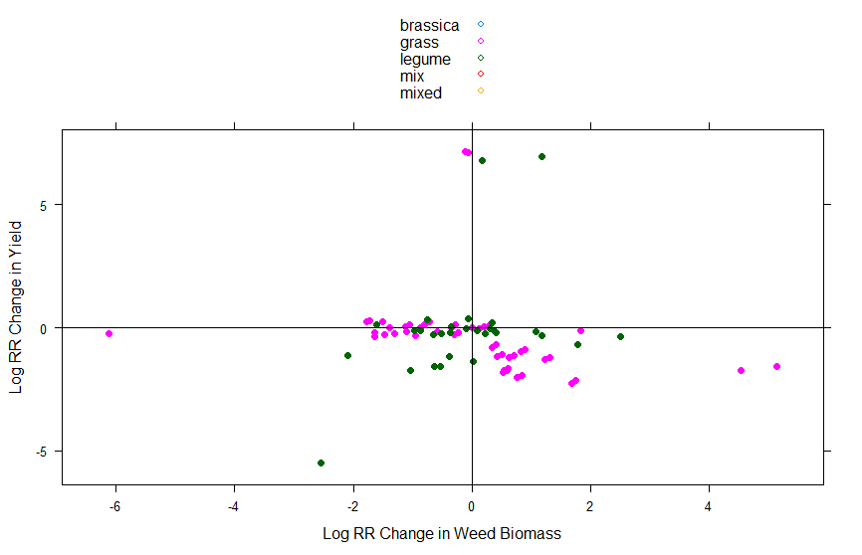
“win win” graphs – weed biomass
Win win
17 or 16%
5 or 5%
23 or 22%
60 or 57%
Lose lose
Notes:
Note that this would only graph where there was a RR for both weed biomass and yield – by my count doing subsets in R I got 105 total here
Its possible that my counts are off – I want to do double check these

Slide 11
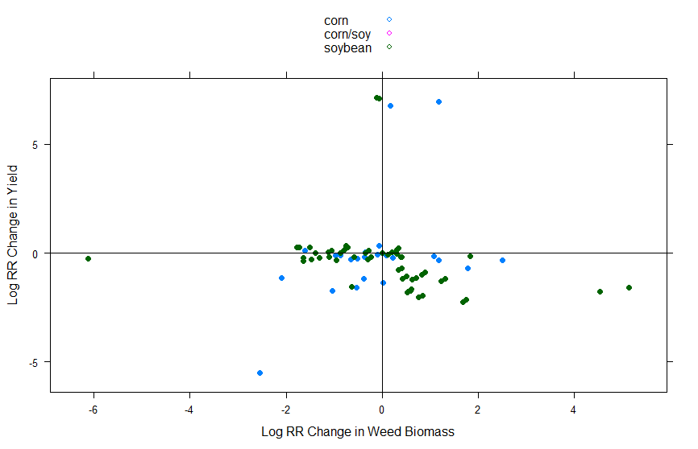
“win win” graphs – weed biomass – corn vs. soy
Win win
Lose lose
Notes:
Note that this would only graph where there was a RR for both weed biomass and yield
To me this demonstrates that in the region we are considering it is difficult not to reduce yields – at least in the way that cover crops are typically managed in research experiments
Doesn’t seem to be a difference between corn or soybean yield

Slide 12
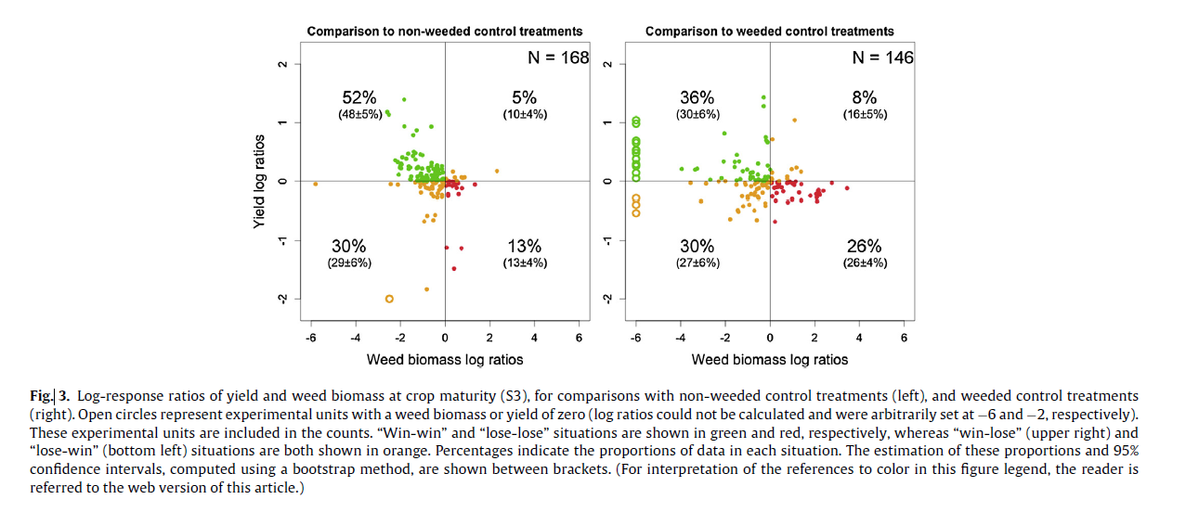
Verret et al. 2017 paper “win win” diagram

Slide 13
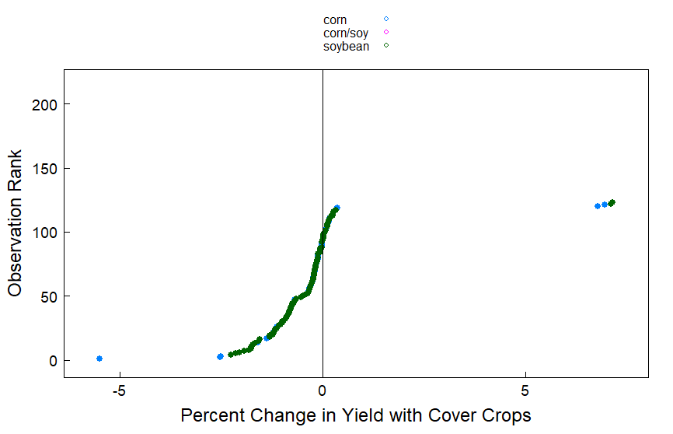
More on yields: 93 negative, 29 positive
Notes:
123 yield RRs, 93 negative, 29 positive (1 must be exactly zero or no change)
Which are the very high positives??

Slide 14
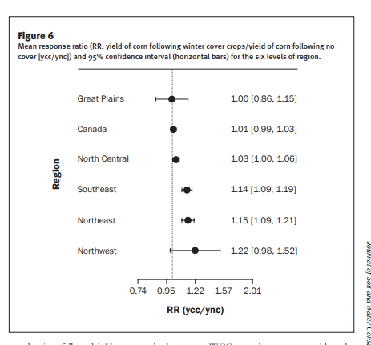
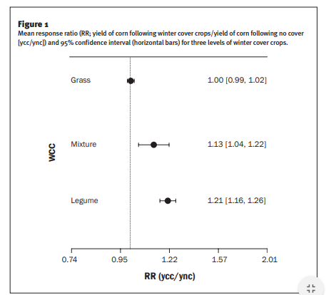
Marcillo and Miguez 2017 – we are in the hardest place to get positive yield effects

Slide 15
From Sarah’s July 2017 presentation

Slide 16
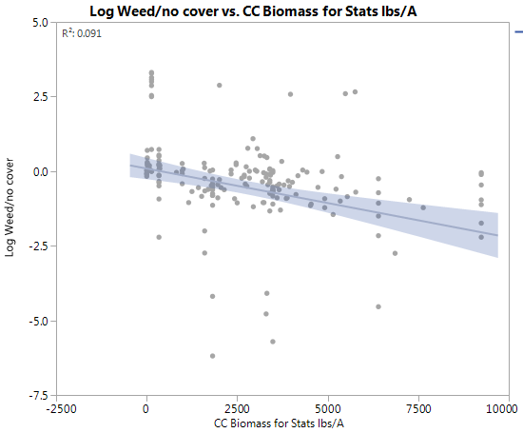
Notes:
Sarah also had many RR that showed an increase in weed biomass

Slide 17
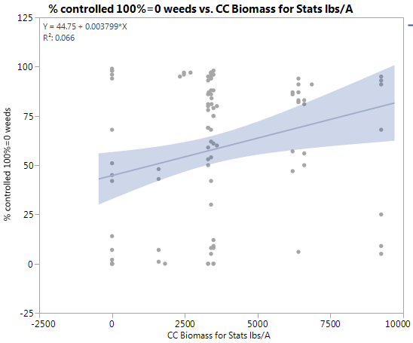

Slide 18
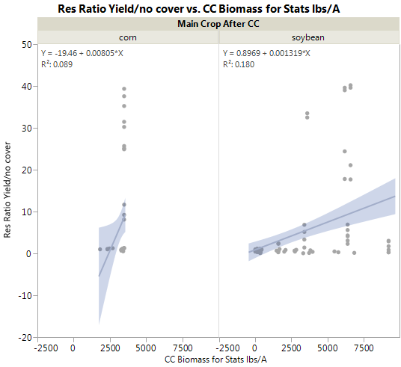

Slide 19
Questions/discussion
Did we miss any studies that need to be excluded? These figures don’t include the interseeding MI study
Not done anything for weighting factors or stats yet. Need to figure out the best way to deal with the 0 values for weeds in the cover crop (Verret paper seemed to assign a “dummy” value)
Added a few variables to the CSV file only – see notes below
Notes:
The variables that I added – only in the csv file
Study #
Month no. for planting date
Julian DOY for planting and termination dates – we should talk more about QC for this. Some of the dates did not have years so I defaulted to 2018. Unless this was a leap year that is an OK assumption but we may have days that are off by 1 DOY. I also did the conversion in excel which made it a little wonky (I could only get the formula to work by adding the year which I then had to text to column separate to remove)
Term method 2 – herbicide, mechanical, dual (mowing + herbicide), winter
We could ungroup some of the M categories but we need to be more standardized in that column

Slide 20
Next steps and more questions
Are we OK with the database as is? Do the positive weed density/biomass values make sense? Verret paper has 34 studies. Right now we have 12 which comparably is pretty good in my opinion
Thinking through the infinity values/0 weeds in the cover crop plots
Weighting factor – if all the reps are the same it isn’t going to make a difference
How to come up with the 50% reduction value in a reasonable way – if that’s our goal
Other variables we want to include – I didn’t yet look at termination method or planting/termination timing in any detail
Database cleanup and organizing – a few variables that we should standardize, renaming variables, etc.

